Slide 1
Library Management System
By Espire System

Slide 2
About Espire Systems Private Limited
ESPIRE SYSTEM PVT. LTD was established in the year 2010 and is a sister concern of ASMACS LTD.
Our end to end and flexible solutions help organizations reduce costs and meet strategic objectives.
We partner with our clients and deliver value added solutions helping our clients extract maximum value from minimal investments.
Headquartered in the financial capital of India - Mumbai, ESPIRE SYSTEM PVT. LTD. is located in 16 locations.

Slide 3
Library Management System
A library Management is used by companies to issue hard copy books primarily but it is also used to lend other resources like ebook and media like videos, music, pictures and other items.
This system is an existing Library Management System product which was recently implemented for a client.
It can be enhanced to meet your needs further.

Slide 4
The Process
2. Search Item
3. Issue Book
4. Issue eBook
5. Issue Media
9. Save & Approve Invoices
10. LogOut
6. Archive Media
8. Save Maps
7. Return Item
1. Login

Slide 5
Features
Book Management
Creation
Modification
Deletion
Issue
Return
Ebook Management
Creation
Modification
Deletion
Issue
Download
Preview
Return

Slide 6
Features
Map Management
Add / Modify /Delete Maps
Download Maps
Invoices Management
Add / Modify /Delete Invoices
Preview Invoices
Approve / UnApprove Invoices
Media Management
Add/Modify Delete Media
Manage Favourite Media
Archive Media
View Media
Reports
Items Issued Report

Slide 7
Features
User Management
Add / Modify /Delete Users
Add / Modify / Delete Roles
Role based Security
Enhanced Security
Media access needs OTP based security
Login needs captcha security
Home page display of New Books Added this Week with auto updation

Slide 8
Upcoming Planned Features
Digitally Signing the Invoice documents
Intelligent RFQ

Slide 9
Login
User name
Enter user Name
Password
Enter password
Seurity Captcha
Added Security Captcha based Login

Slide 10
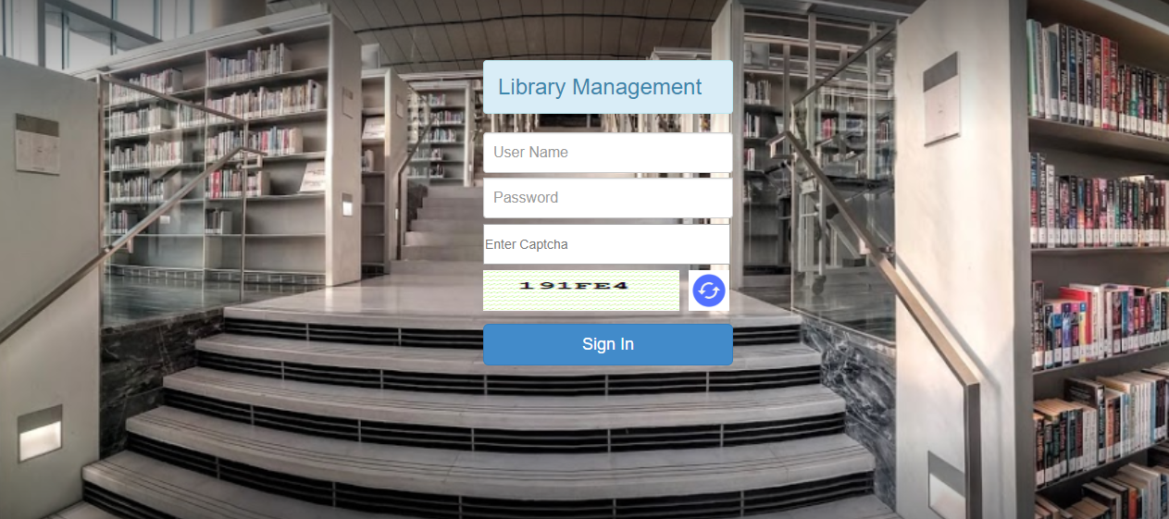
Library Management – home page
Go Back

Slide 11
Search Library Items
Go Back
Search By Book Name, ISBN, Author /Publisher name
Search By Book Name and Author name
Search Ebooks
Search Books
Search Media
Search By media type and Media Title

Slide 12
Issue Book
Search/Select
Book
Click on Book name/ Details
Enter Details
Save and Borrow the book
Issue Book to user

Slide 13
Library Management – Issue Book
Go Back

Slide 14
Issue/ Use eBook
Search/Select E-Book
Click on eBook Name/Details
Enter Details
Issue E-Book to User
Download Ebook

Slide 15
Library Management Issue EBooks
Go Back

Slide 16
Issue / Use Media
Go Back
Download/View
Media
Save Media
Add Media
Search/Select Media

Slide 17
Save Maps
Search/Select
Maps
Add Maps
Enter Details
Save Maps

Slide 18
Use/Issue Media- Security

Slide 19
Use/Issue Media- Security

Slide 20
Use/Issue Media- View

Slide 21
Return Items
Search/Select
Book
Click on Book name/ Details
Go to the Book Issue Details section
Click on Return Book
Confirm

Slide 22
Reports
List of books and ebooks issued by User

Slide 23
Log Out
Go Back

Slide 24
Upcoming My Library

Slide 25
Intelligent RFQ

Slide 26
Intelligent RFQ

Slide 27
Proposed Architecture and Technology Stack

