Slide 1
Geo ATS
Espire System Pvt Ltd

Slide 2
Geo ATS –Features beta
A platform to Track/show the route taken by a vehicle or an individual
Works through the use of a smart mobile phone which acts as a GPS device
Shows characteristics like Latitude, Longitude, speed, Phone battery level, Distance and Total Distance travelled
It is a Cloud based Solution
GeoATS has a real-time map view

Slide 3
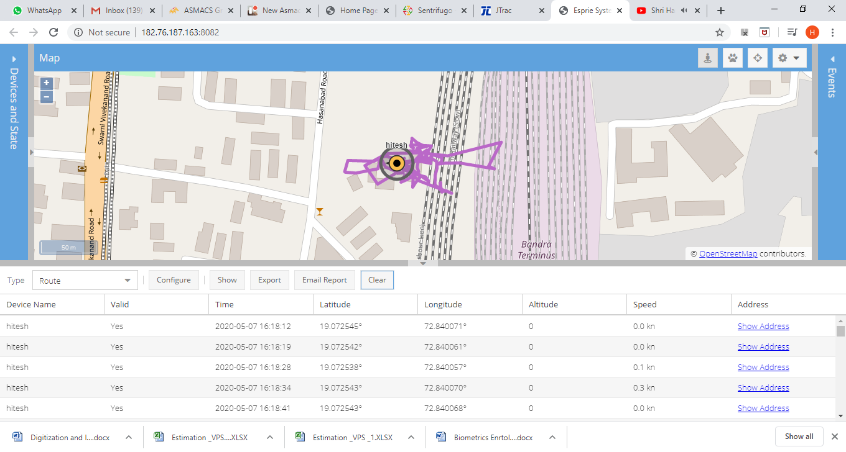
GeoATS-Route

Slide 4
GeoATS-Speed

Slide 5
GeoATS Components
Traccar Mobile Client
Geo ATS Server Server

Slide 6
GeoATS - Configure
Configure GeoATS Client
Install Traccar Client (green logo) from Google Play Store on mobile device.
Configure the client by updating the server URL to http://182.75.187.163:8082
Update Frequency to 5 seconds

Slide 7
GeoATS - Configure
Configure GeoATS Server
Login to the Server at http://182.76.187.163:8082/
Add the recently configured client by adding the Device Name and the Device Identifier on the server

Slide 8
Track / View Device
Login to the server at http://182.76.187.163:8082/
Under Reports section; in the type Select Route
Click Configure to select the Device/Individual name, period of route information to view, check Show markers
Click on Show button to view the Route taken by the device

Slide 9
Thank You

