Slide 1
SMS- School Management System (DigiCampus)

Slide 2
DigiCampus Components
Digi-campus
Academics
Operation
Self Service (Students & Parents View)
Finance
Analytics (Mgmt View)
Self Service (Teachers View)
DigiCampus suite is a education management platform hosted on the cloud for administrators , students & parents.

Slide 3
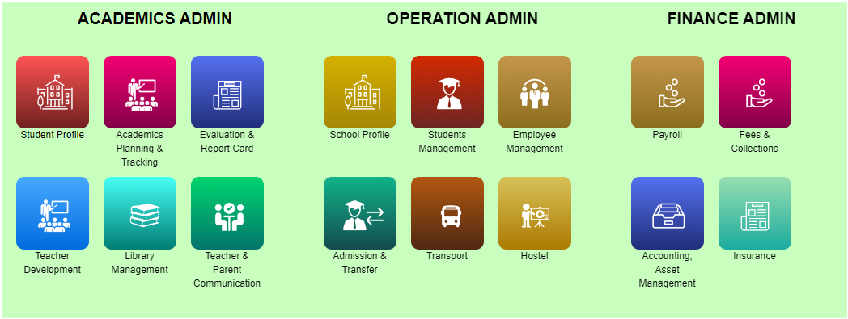
Digicampus- Modules
Operation
Facility Management (School profile management)
Student Management
Admission & Transfer
Employee Management
Transport
Hostel
Finance
Fee Management & Collections
Accounting & Payroll
Procurement
Insurance Management
Academics
Student information system (View Only)
Academics Planning & Tracking
Evaluation & Report Card
Teacher Development
Library
Teacher Parent Communication

Slide 4
DigiCampus –Users View
Won’t you be glad to get timely updates about your child’s academic performance? Will you not be excited to receive institutes' latest announcements/events in your mobile?
Don’t you think the availability of vital student information or reports at your finger tips will increase your productivity?
Don’t you want to avoid time consuming queues for fee payments or application forms for internal/external exams?
1q
Teachers/Staff
Students
Parents
Schools

Slide 5
DigiCampus – Users View
School Users
Academics Admin: Aggregated academics data of a school
Operation User: Can access school, student, faculty, transport, HR, Events data)
Finance user: Fee, procurement, Inventory & store, insurance data
NB: Principal – Principal can view all data of his/her school
Students/Parents
Admission data
Own profile, fee & academics data
School communication
Teacher
Own data, attendance & students data
Marks & report card of their students
All communication
Management
All school aggregated data under their jurisdiction of the command
Reports & dashboard

Slide 6
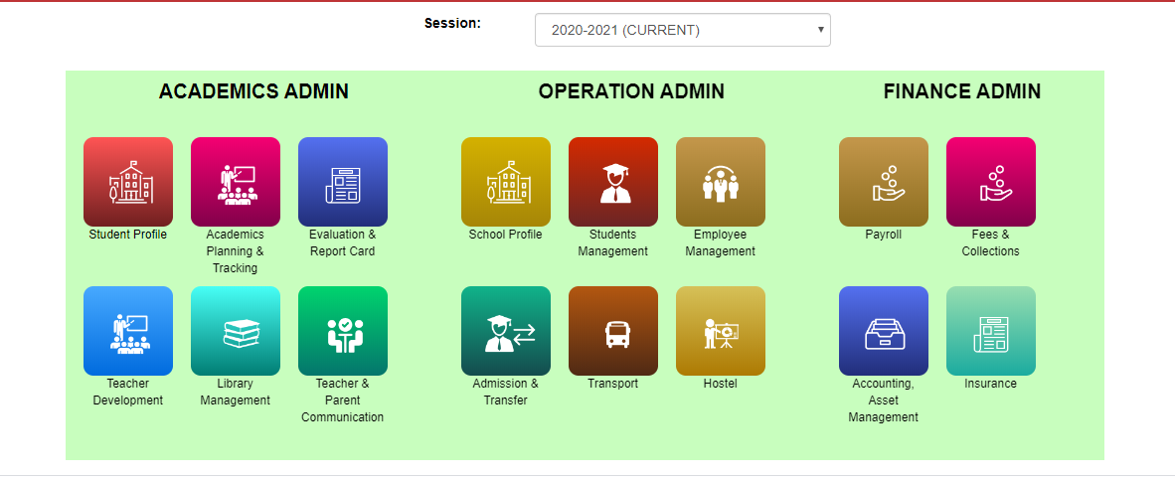
Admin-Principal

Slide 7
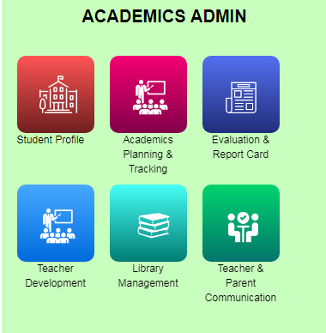
Academics Admin
Student Profile
Academics Planning and Tracking
Evaluation and Report Card
Teacher Development
Library Management
Parent and Teacher Communication

Slide 8
Student Profile
Search Students details by Course, Class, Section, Admission No. and Name.
Also, see Payment details, Academic report and Student details.
Generate Certificates like TC, Fee Certificate, Challan etc.

Slide 9
Academics Planning
Academics Master Setup
Session Management – Promotion to students from one session to next session
Subject Management – Mapping course to subjects
Section allotment to Student
Teacher Assign – Assign Teacher to particular class, section and subject.
Daily Student Attendance
Reports on Academics activities

Slide 10
Evaluation and Report Card
Exam setup
Define Exams
Exam Types
Exam Subjects
Exam Subject and Type Mapping
Exam Mark entry.
Exam Consolidated Reports
Report Card setup and Generation.

Slide 11
Teacher Development
Training – Schedule training programs for teacher development. Also, add trainer details.
Achievements – Manage and Verify Teacher achievements.
Reports – Generate Teacher training and participation reports.

Slide 12
Library Management
Library Setup
Book uploading in bulk against their Accession Number.
Book issue/return to student and employee.
Stock Verification
Barcode generation.
Library card (Student and Employee) generation.

Slide 13
Teacher and Parent Communication
Send notification to Students and Employee.
Send Document of Student and Employee
Send Message to Students and Employee.

Slide 14
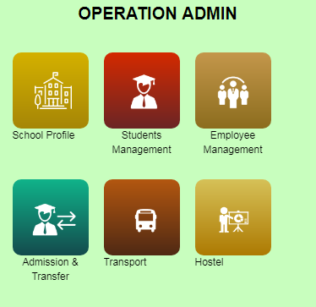
Operations Admin
School Profile
Student Management
Employee Management (HRMS)
Admission and Transfer
Transport
Hostel

Slide 15
School Profile
Individual School can manage their School profile like Accommodation, Awards and Recognition, Facilities (Transport, Library etc.) , Infrastructure, Documents and Miscellaneous (School type, streams, EPFO etc).

Slide 16
Student Management
Add new student (Admission) single as well as in bulk.
Upload documents like student Photo, Aadhaar, Birth Certificate etc.
Edit Student details
Give them TC and Struck off as required.
Generate on-demand certificates like Challan, TC, Character Certificate etc.
Generate different types of academics reports as required by schools.
New Admission registration details.

Slide 17
Employee Management
Profile, Attendance and Leave Setup.
Joining of employees single as well as in bulk.
Attendance (Biometric Integration) and Leave management.
Updating from Probation to Confirm (employment)
Exit employee.
Rejoin the Exit employee.
Reports

Slide 18
Admission and Transfer
This Module is a part of Student Management.
Admit new students Single as well bulk.
Give them TC single as well as bulk.

Slide 19
Transport
Managing Vehicle.
Daily Running Log
Maintenance Log

Slide 20
Hostel
Hostel Room Allotment
Hostel Student Attendance
Hostel Student Leave
Hostel Exit
Hostel Bed Swap/Transfer
Headbath and Haircut Register
Slot wise Hostel Attendance
Item purchase register
Card Register
Report

Slide 21
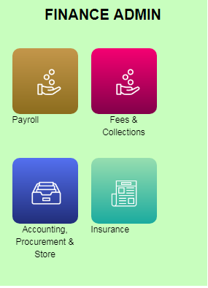
Finance Admin
Payroll
Fee and Collection
Accounting, Procurement and Store
Insurance

Slide 22
Payroll
Master Setup
Salary Calculation including Earnings, Deductions, Additional Earning, Additional Deduction.
LOP and Arrear Calculation
TDS Calculation
Generate Salary Slip, Bank Statement, EPFO, ESIC etc
Generate Form-16

Slide 23
Fee and Collection
Fee Account setup.
One time and Recurring fee setup.
Late fee setup.
Generate One time, Recurring and Late fee.
Create Due for one time and Recurring.
Collection (Online and Offline)
Transaction.
Adjustment
Online transaction report.
Cancellation of Due and Collection.
waive off.

Slide 24
Accounting and Store
Accounting
Budget
Account and Entity setup.
Transactions- Expenditure, Receipts and Journal Entry
Receipt Report.
Expenditure Report.
Balance Sheet.
Ledger Report.
Store
Store setup.
Transactions- Asset Received, Issue and update.
Reports – ASTB, Received, Issued and Stock

Slide 25
Insurance
Student Insurance Policy details.
Staff Insurance Policy details.

Slide 26
Teacher View(Self Service)
Attendance
Mark Entry
View Student Details
Generate Report Card
Send Notice, Documents(HW) & SMS to students.
HR Activities (In-Out Timing, Profile, Leave application, Library Status etc.)

Slide 27
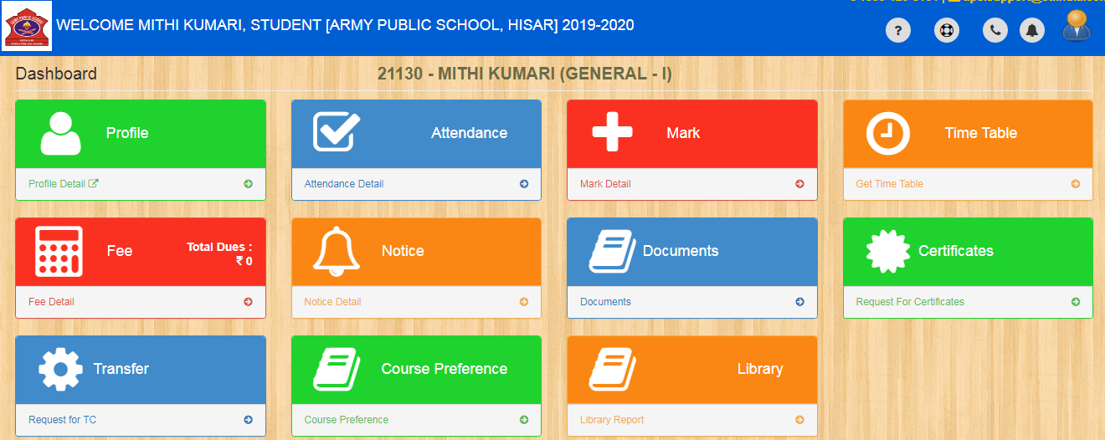
Student/Parent View (Self Service)
View Profile, Attendance & Mark Entry.
Due date of Fee and Pay online fee (Internet Req.)
Notice & Documents.
Request for Certificates and TC.
Library Status.

Slide 28
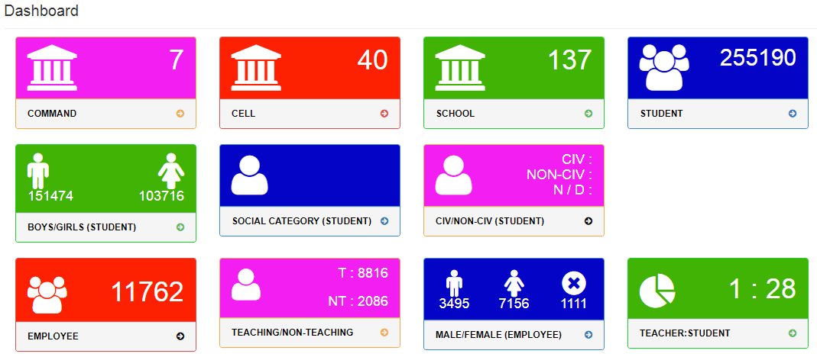
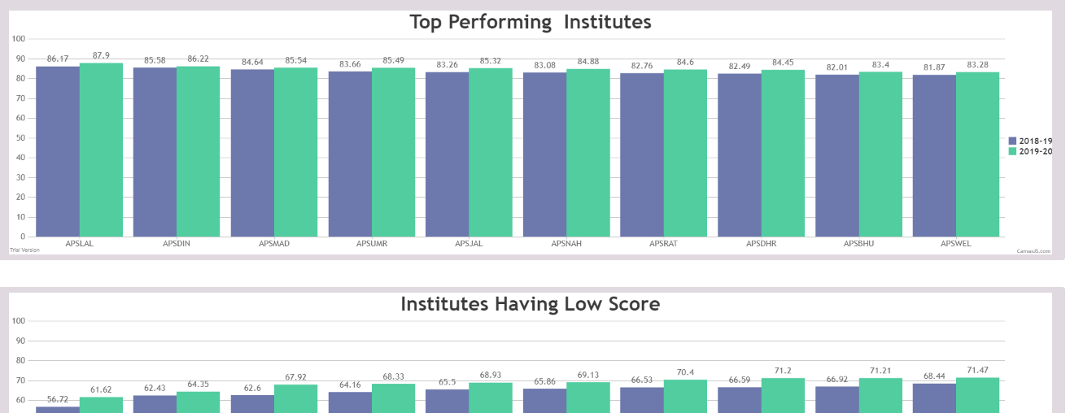
Management
Can view consolidated dashboard reports in one place
Can view Analytics reports across year on Student, Employee, Finance etc

Slide 29
Thank You
The journey begins……….

