Slide 1
Attendance Tracking System
A Product of:
An ASMACS group of Company

Slide 2
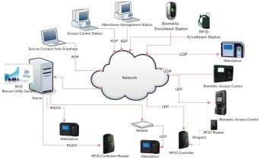
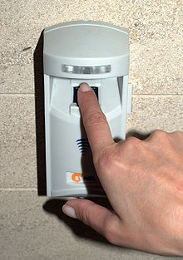
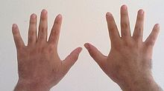
Features of Biometric Attendance Tracking System
Cloud based attendance System
Register once and use multi-location
Registers up to 10 fingers

Slide 3
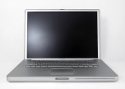
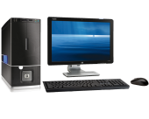
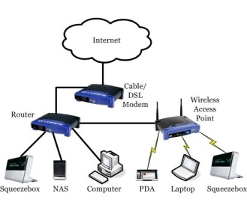
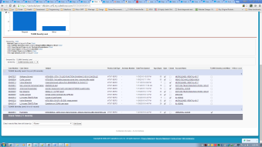
Features of Biometric Attendance Tracking System
Light weight application works on- line and off-line mode
Supports network of PC/Laptop (WIFI/LAN)
Customized real time reports and email alerts

Slide 4
Biometric Attendance Tracking System - Registration

Slide 5
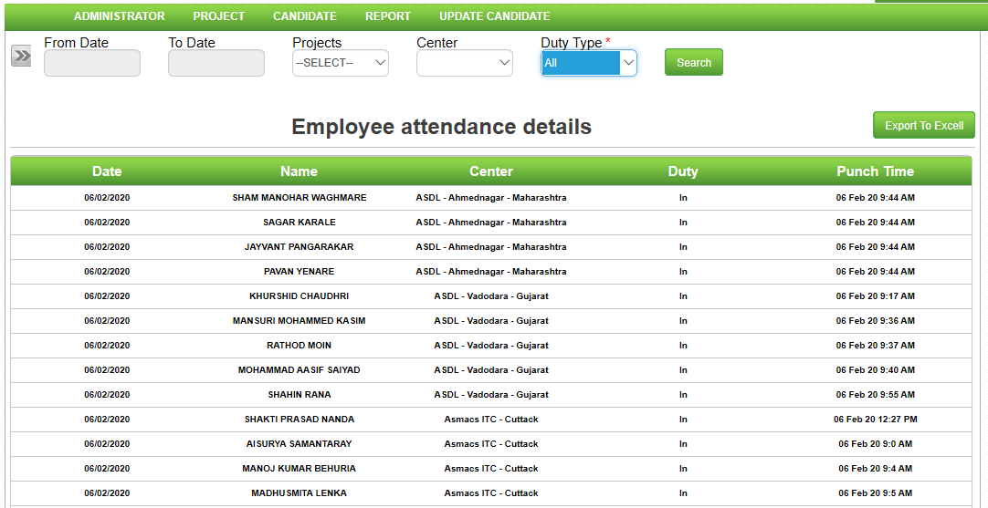
Biometric Attendance Tracking System - Sample report

Slide 6
Sample Device used for the System

Slide 7
Device Specifications
General
Brand Mantra Model Name MFS100 Biometric Fingerprint USB Device With RD Services
Color Silver and Black
Shade Black and Silver
System Requirements
Supports Windows 7,8,10, Windows Vista, Windows 2000,Windows Server 2003/2007/2008, Linux, Windows ME, Windows 98 SE SDK, Libraries and Drivers support across all above Platforms. (32 Bit and 64Bit) Easy Integration on to production servers and application support.
Light Source Optical Fingerprint Sensor (scratch free sensor surface)
Image Sensor Optical Fingerprint Sensor
Output Type Color
Output Format Digital Imprint
Scanner Features
Scanning Resolution 500 dpi
No display
Connectivity Features
Connection Interface USB 2.0, USB 3.0
Connectivity via USB, Mobile Connectivity via Micro-USB (USB to Micro-USB converter)

Slide 8
DR DEV MOHANTY
FOUNDER - CHAIRMAN
ASMACS GROUP
411 Sai Chamber, 4th Floor,
Opp. Railway Stn, Santacruz ( E )
Mumbai 400 055
Tel:+91-22-26125301/26180997
Fax:+91-22-26147103
www.asmacsgroup.net
Thank You
Qatar Branch Details:
ASMACS SUPPORT SERVICE W.L.L
PO BOX: 30817,DOHA-QATAR
Tel:+974-44513940/44513941
Fax:+974-44513942
email: engineeringqatar@asmacsglobal.com
: qatar@asmacsglobal.com
www.asmacsgroup.net

